Slide 1
Human Computer Interaction
The computer part I
Text entry devices
CS 8th Semester

Slide 2
The Computer
A computer system is made up of various elements. Each of these elements affects the interaction
Input Devices – Text Entry And Pointing
Output Devices – Screen (Small & Large), Digital Paper
Virtual Reality – Special Interaction And Display Devices
Physical Interaction – E.G. Sound, Haptic, Bio-sensing
Paper – As Output (Print) And Input (Scan)
Memory – RAM & Permanent Media, Capacity & Access
Processing – Speed Of Processing, Networks

Slide 3
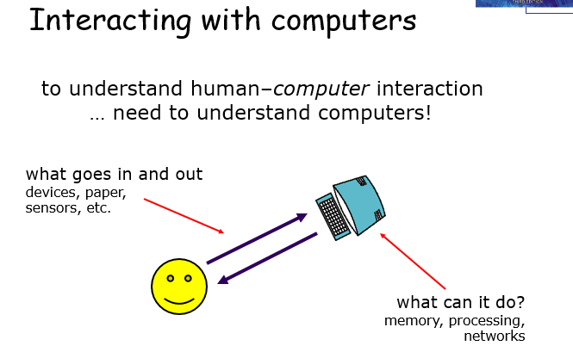
Interacting with Computers

Slide 4
A ‘typical’ computer system
?
Screen, or monitor, on which there are windows
Keyboard
Mouse/trackpad
variations
Desktop
Laptop
PDA
The devices dictate the styles of interaction that the system supports
If we use different devices, then the interface will support a different style of interaction

Slide 5
How many computers …
in your house?
PC
TV, VCR, DVD, HiFi, cable/satellite TV
microwave, cooker, washing machine
central heating
security system
can you think of more?
in your pockets?
PDA
phone, camera
smart card, card with magnetic strip?
electronic car key
USB memory
try your pockets and bags

Slide 6
Interactivity?
Long ago in a galaxy far away … batch processing
punched card stacks or large data files prepared
long wait ….
line printer output
… and if it is not right …
Now most computing is interactive
rapid feedback
the user in control (most of the time)
doing rather than thinking …
Is faster always better?

Slide 7
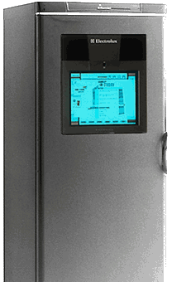

Richer interaction
sensors
and devices
everywhere

Slide 8
Why Human interact with Computers?
When we interact with computers, what are we trying to achieve?
Consider what happens when we interact with each other:
we are either passing information to other people,
or receiving information from them.
Often, the information we receive is in response to the information that we have recently imparted to them, and we may then respond to that.
Interaction is therefore a process of information transfer. Relating this to the electronic computer, the same principles hold: interaction is a process of information transfer, from the user to the computer and from the computer to the user.

Slide 9
Levels of Interaction
Batch processing:
In the early days of computing, information was entered into the computer in a large mass i.e batch data entry. There was minimal interaction with the machine: the user would simply dump a pile of punched cards onto a reader, press the start button, and then return a few hours later.
With batch processing the interactions take place over hours or days. In contrast the typical desktop computer system has interactions taking seconds or fractions of a second (or with slow web pages sometimes minutes!). The field of Human–Computer Interaction largely grew due to this change in interactive pace.
Richer interaction – Everywhere, Everyone :
Computers are coming out of the box! Information appliances are putting internet access or dedicated systems onto the fridge, microwave and washing machine: to automate shopping, give you email in your kitchen or simply call for maintenance when needed. We carry with us WAP phones and smartcards, have security systems that monitor us and webcams that show our homes to the world.

Slide 10
Text Entry Devices (Input)
Keyboards (QWERTY )
Handwriting Recognition
Speech Recognition

Slide 11
Text Entry Devices-1.Keyboard
Whether writing a book, producing an office memo, or simply sending an email to a friend, entering text is one of our main activities when using the computer. The most obvious means of text entry is the plain keyboard,
1. The Alphanumeric Keyboard: The keyboard is still one of the most common input devices in use today. It is used for entering textual data and commands. The vast majority of keyboards have a standardized layout, and are known by the first six letters of the top row of alphabetical keys, QWERTY. There are alternative designs which have some advantages over the QWERTY layout, but these have not been able to overcome the vast technological advantages of the QWERTY keyboard. There are various alternatives of keyboard: 26 key layouts and chord keyboards, Phone pad and T9 entry etc.

Slide 12
2. Handwriting Recognition(HWR)
Handwriting is a common and familiar activity, and is therefore attractive as a method of text entry. If we were able to write as we would when we use paper, but with the computer taking this form of input and converting it to text, we can see that it is a simple way of interacting with the computer. However, there are a number of disadvantages with handwriting recognition.
Current technology is still fairly inaccurate and so makes a significant number of mistakes in recognizing letters, though it has improved rapidly.
Moreover, individual differences in handwriting are enormous, and make the recognition process even more difficult. The most significant information in handwriting is not in the letter shape itself but in the stroke information – the way in which the letter is drawn.
This means that devices which support handwriting recognition must capture the stroke information, not just the final character shape. the context can help determine the letter’s identity, but is often unable to provide enough information.
Deep learning has been widely used to recognize handwriting.

Slide 13
3. Speech Recognition
Speech recognition, or speech-to-text, is the ability for a machine to identify words spoken aloud and convert them into readable text. However speech recognition software has a limited vocabulary of words and phrases, and it may only identify these if they are spoken very clearly.
Use: Speech recognition incorporates different fields of research in computer science, linguistics and computer engineering. Many modern devices or text-focused programs may have speech recognition functions in them to allow for easier or hands-free use of a device.
Speech recognition and Voice recognition are different things. Speech recognition is used to identify words in spoken language. Voice recognition is a biometric technology used to identify a particular individual's voice or for speaker identification.

Slide 14
Advantages and Disadvantages of SR
Advantage:
Speech recognition software are easy to use and readily available.
Speech recognition software is now frequently installed in computers and mobile devices, allowing for easy access.
Disadvantage:
It is unable to sometimes capture words due to variations of pronunciation,
its lack of support for some languages
and its inability to sort through background noise.
These factors can lead to inaccuracies. Some speech recognition software may also take time and feel relatively slow to process speech. Speech recognition technology still has a few issues to work through, as it is continuously developed.

